Slide 1
Cover Letter Generator Using NLP and Deep Learning
Rachel Khoo
Thinkful Final Capstone
December 2020

Slide 2
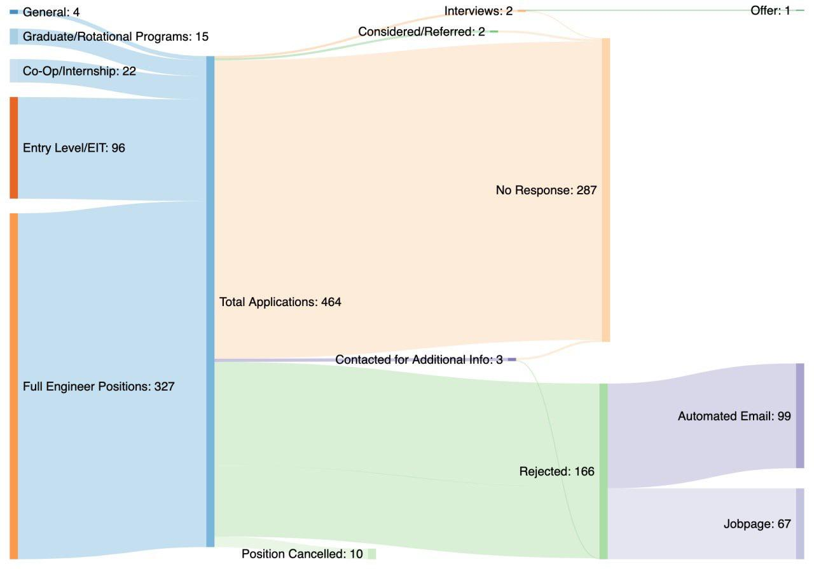
62% No response
Reddit user Majikthese

Slide 3
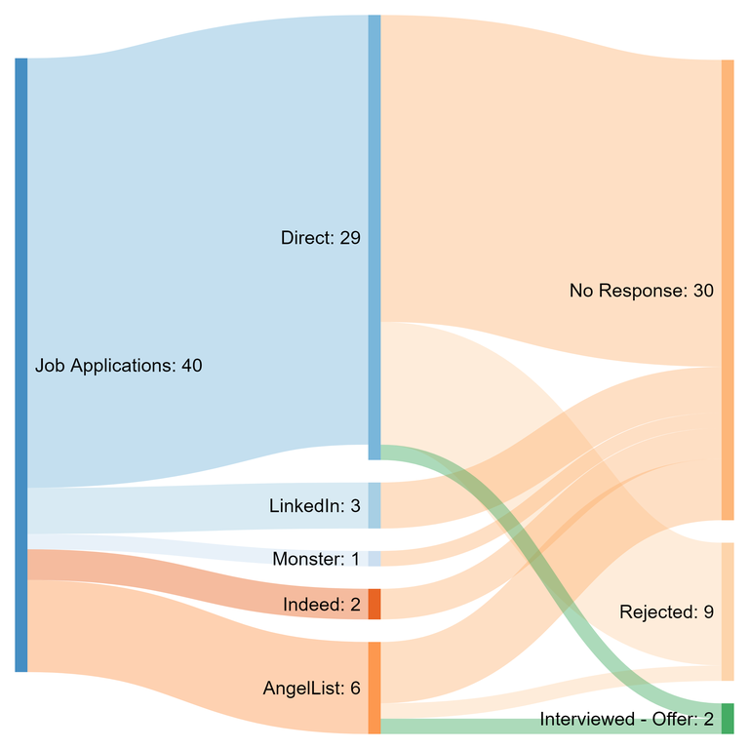
75% No response
Reddit user lightningboy_

Slide 4
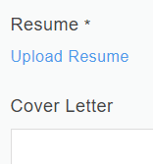
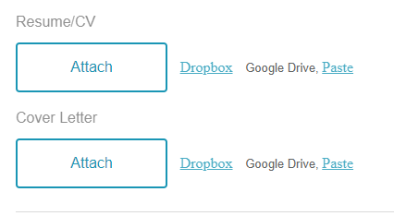
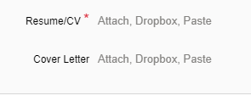
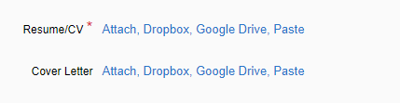


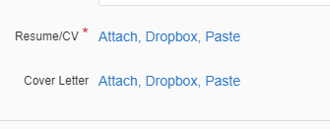
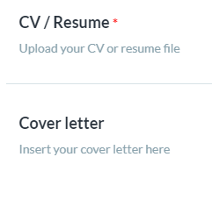
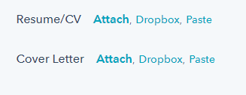
How do you set yourself apart?

Slide 5
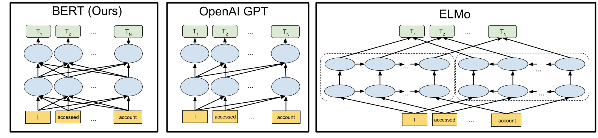
NLP and Deep Learning
BERT Encoder
LSTM neural net
https://towardsdatascience.com/bert-in-keras-with-tensorflow-hub-76bcbc9417b
Notes:
Bidirectional Encoder Representations from Transformers

Slide 6
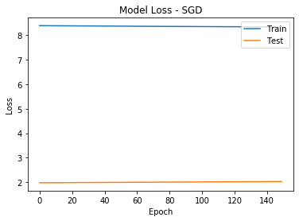
SGD Optimizer
Input: “I would like to apply”

Slide 7
SGD Optimizer
Output: “I would like to apply and and and and and
and and and and and and and and and and
and and and and and and and and and and”

Slide 8
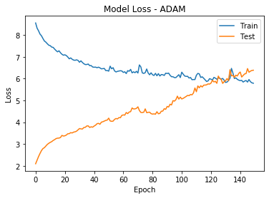
ADAM Optimizer
Input: “I would like to apply”
Notes:
Losses begin to converge, with more epochs they diverge again

Slide 9
ADAM Optimizer
Output: “I would like to apply on-strategy yourcompany consideration
a yourcompany problem-solving confident the me passionate
cost me passionate cost me passionate cost me passionate
cost me passionate cost me passionate”

Slide 10

There is more work to be done
More training data
Tuning hyperparameters
Using resume as input
“data science”, “collaborative”, “communication”, “teamwork”

